Slide 1
Radisoity
Ed Angel
Professor of Computer Science, Electrical and Computer Engineering, and Media Arts
Director, Arts Technology Center
University of New Mexico
Angel: Interactive Computer Graphics 5E © Addison-Wesley 2009

Slide 2
Introduction
Ray tracing is best with many highly specular sufaces
  Not characteristic of real scenes
Rendering equation describes general shading problem
Radiosity solves rendering equation for perfectly diffuse surfaces
Angel: Interactive Computer Graphics 5E © Addison-Wesley 2009

Slide 3
Terminology
Energy ~ light (incident, transmitted)
  Must be conserved
Energy flux = luminous flux = power = energy/unit time
  Measured in lumens
  Depends on wavelength so we can integrate over spectrum using luminous efficiency curve of sensor
Energy density (Φ) = energy flux/unit area
Angel: Interactive Computer Graphics 5E © Addison-Wesley 2009

Slide 4
Terminology
Intensity ~ brightness
  Brightness is perceptual
= flux/area-solid angle = power/unit projected area per solid angle
  Measured in candela
Φ = ∫ ∫ I dA dω
Angel: Interactive Computer Graphics 5E © Addison-Wesley 2009

Slide 5
Rendering Eqn (Kajiya)
Consider a point on a surface
N
I_{in}(Φ_{in})
I_{out}(Φ_{out})
Angel: Interactive Computer Graphics 5E © Addison-Wesley 2009

Slide 6
Rendering Equation
Outgoing light is from two sources
  Emission
  Reflection of incoming light
Must integrate over all incoming light
  Integrate over hemisphere
Must account for foreshortening of incoming light
Angel: Interactive Computer Graphics 5E © Addison-Wesley 2009

Slide 7
Rendering Equation
I_{out}(Φ_{out}) = E(Φ_{out}) + ∫ _{2π}R_{bd}(Φ_{out}, Φ_{in} )I_{in}(Φ_{in}) cos θ dω
emission
angle between normal and Φin
bidirectional reflection coefficient
Note that angle is really two angles in 3D and wavelength is fixed
Angel: Interactive Computer Graphics 5E © Addison-Wesley 2009

Slide 8
Rendering Equation
Rendering equation is an energy balance
  Energy in = energy out
Integrate over hemisphere
Fredholm integral equation
  Cannot be solved analytically in general
Various approximations of R_{bd} give standard rendering models
Should also add an occlusion term in front of right side to account for other objects blocking light from reaching surface
Angel: Interactive Computer Graphics 5E © Addison-Wesley 2009

Slide 9
Another version
Consider light at a point p arriving from p’
i(p, p’) = υ(p, p’)(ε(p,p’)+ ∫ ρ(p, p’, p’’)i(p’, p’’)dp’’
emission from p’ to p
occlusion = 0 or 1/d²
light reflected at p’ from all
points p’’ towards p
Angel: Interactive Computer Graphics 5E © Addison-Wesley 2009

Slide 10
Radiosity
Consider objects to be broken up into flat patches (which may correspond to the polygons in the model)
Assume that patches are perfectly diffuse reflectors
Radiosity = flux = energy/unit area/ unit time leaving patch
Angel: Interactive Computer Graphics 5E © Addison-Wesley 2009

Slide 11
Notation
n patches numbered 1 to n
b_{i} = radiosity of patch I
a_{i} = area patch I
total intensity leaving patch i = b_{i} a_{i}
e_{i} a_{i} = emitted intensity from patch I
ρ_{i} = reflectivity of patch I
f_{ij} = form factor = fraction of energy leaving patch j that reaches patch i
Angel: Interactive Computer Graphics 5E © Addison-Wesley 2009

Slide 12
Radiosity Equation
energy balance
b_{i}a_{i} = e_{i}a_{i} + ρ_{i} ∑ f_{ji}b_{j}a_{j}
reciprocity
f_{ij}a_{i} = f_{ji}a_{j}
radiosity equation
b_{i} = e_{i} + ρ_{i} ∑ f_{ij}b_{j}
Angel: Interactive Computer Graphics 5E © Addison-Wesley 2009

Slide 13
Matrix Form
b = [b_{i}]
e = [e_{i}]
R = [r_{ij}]
r_{ij} = ρ_{i} if i ≠ j
r_{ii} = 0
F = [f_{ij}]
Angel: Interactive Computer Graphics 5E © Addison-Wesley 2009

Slide 14
Matrix Form
b = e - RFb
formal solution
b = [I-RF]⁻¹e
Not useful since n is usually very large
Alternative: use observation that F is sparse
We will consider determination of form factors later
Angel: Interactive Computer Graphics 5E © Addison-Wesley 2009

Slide 15
Solving the Radiosity Equation
For sparse matrices, iterative methods usually
require only O(n) operations per iteration
Jacobi’s method
b^{k+1} = e - RFb^{k}
Gauss-Seidel: use immediate updates
Angel: Interactive Computer Graphics 5E © Addison-Wesley 2009

Slide 16
Series Approximation
1/(1-x) = 1 + x + x²+ ……
[I-RF]⁻¹ = I + RF +(RF)²+…
b = [I-RF]⁻¹e = e + RFe + (RF)²e +…
Angel: Interactive Computer Graphics 5E © Addison-Wesley 2009

Slide 17
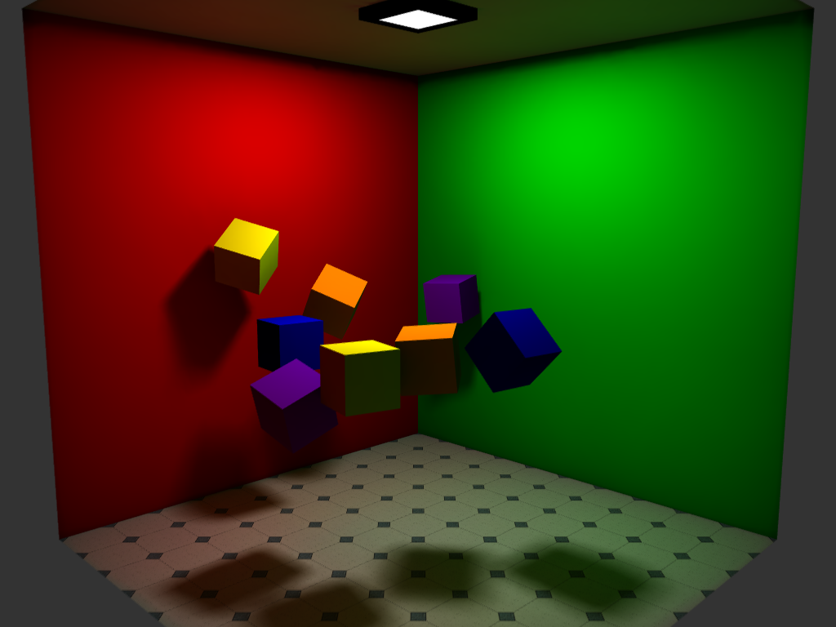
Rendered Image
Angel: Interactive Computer Graphics 5E © Addison-Wesley 2009

Slide 18
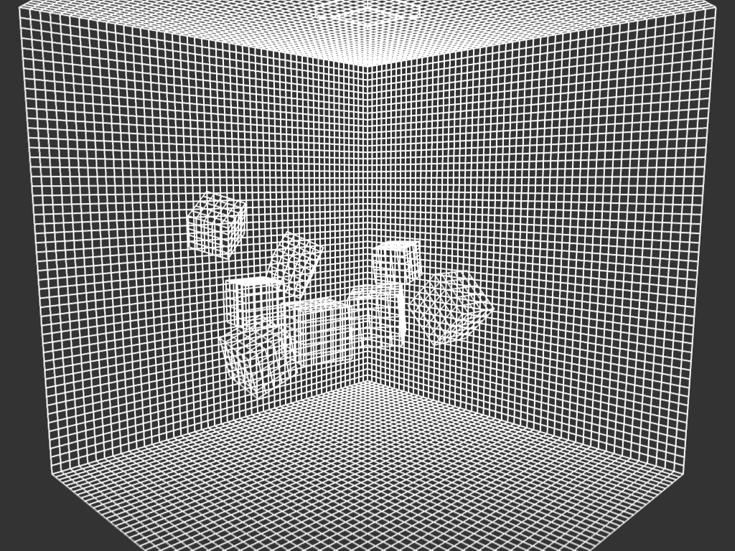
Patches
Angel: Interactive Computer Graphics 5E © Addison-Wesley 2009

Slide 19
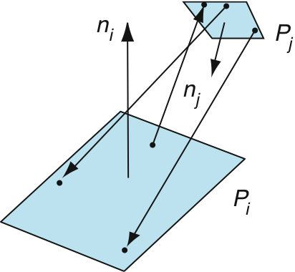
Computing Form Factors
Consider two flat patches
Angel: Interactive Computer Graphics 5E © Addison-Wesley 2009

Slide 20
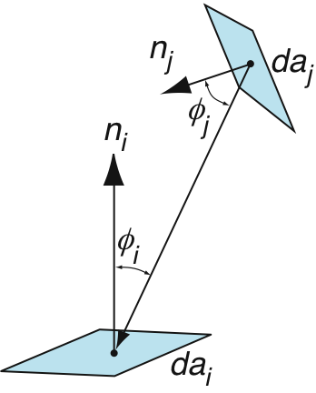
Using Differential Patches
foreshortening
Angel: Interactive Computer Graphics 5E © Addison-Wesley 2009

Slide 21
Form Factor Integral
f_{ij} = (1/a_{i}) ∫_{ai} ∫_{ai} (o_{ij} cos θ_{i} cos θ_{j} / πr² )da_{i} da_{j}
occlusion
foreshortening of patch j
foreshortening of patch i
Angel: Interactive Computer Graphics 5E © Addison-Wesley 2009

Slide 22
Solving the Intergral
There are very few cases where the integral has a (simple) closed form solution
  Occlusion further complicates solution
Alternative is to use numerical methods
Two step process similar to texture mapping
  Hemisphere
  Hemicube
Angel: Interactive Computer Graphics 5E © Addison-Wesley 2009

Slide 23
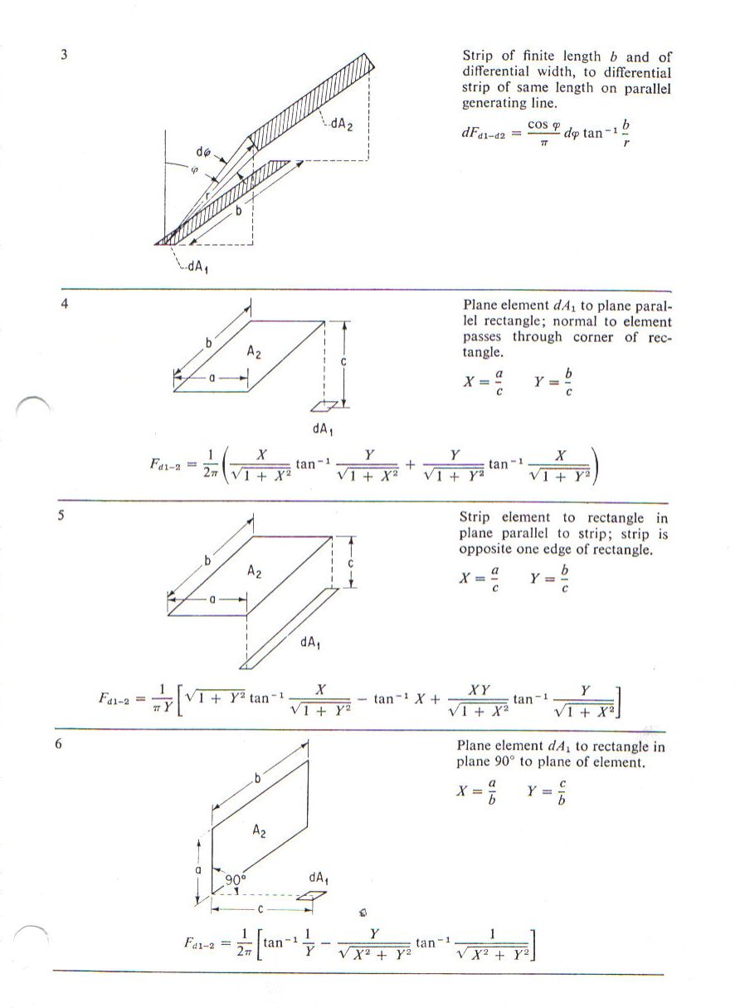
Form Factor Examples 1
Angel: Interactive Computer Graphics 5E © Addison-Wesley 2009

Slide 24
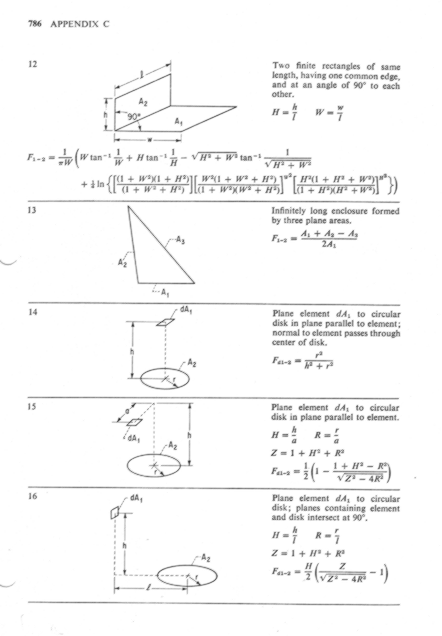
Form Factor Examples 2
Angel: Interactive Computer Graphics 5E © Addison-Wesley 2009

Slide 25
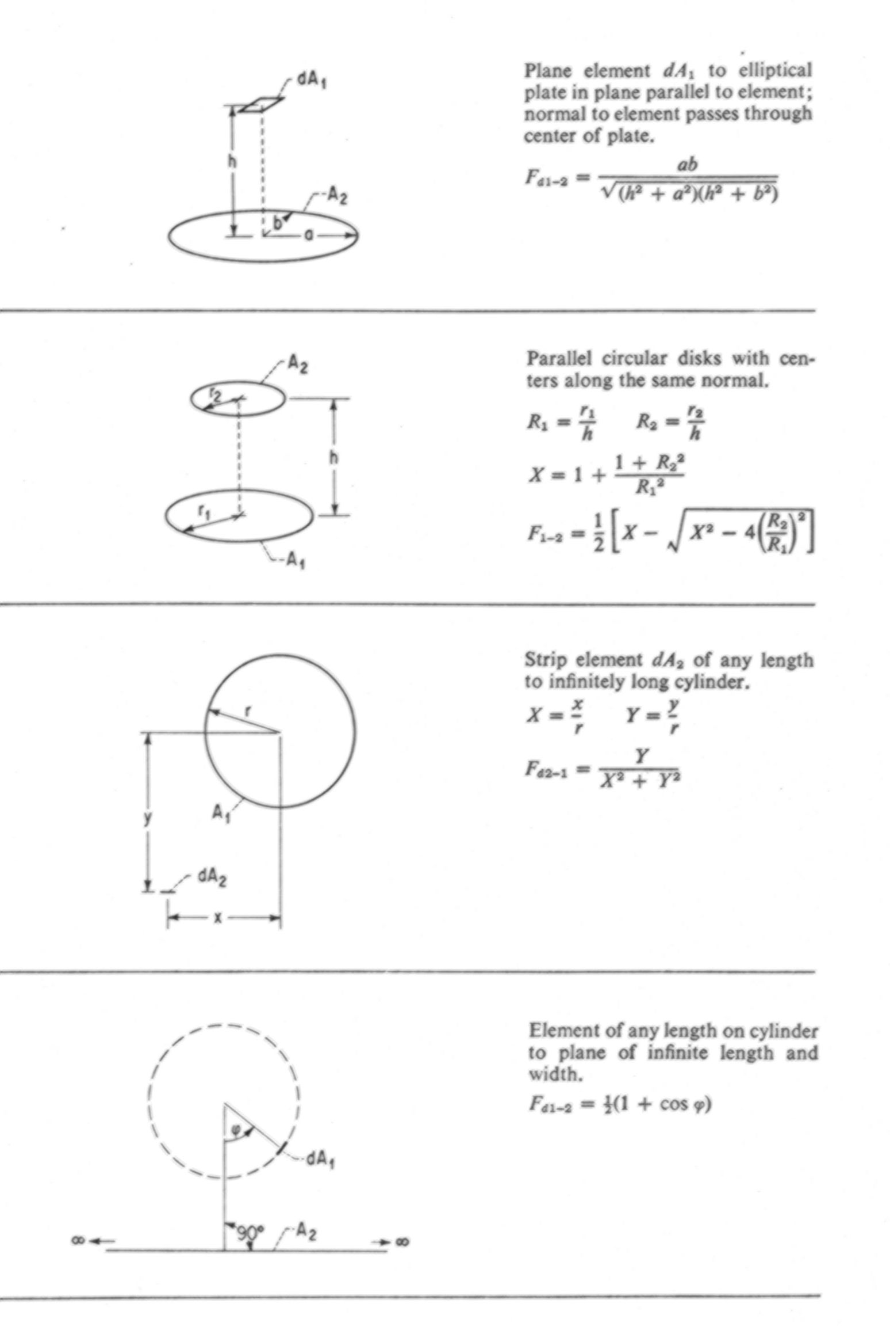
Form Factor Examples 3
Angel: Interactive Computer Graphics 5E © Addison-Wesley 2009

Slide 26
Hemisphere
Use illuminating hemisphere
Center hemisphere on patch with normal pointing up
Must shift hemisphere for each point on patch
Angel: Interactive Computer Graphics 5E © Addison-Wesley 2009

Slide 27
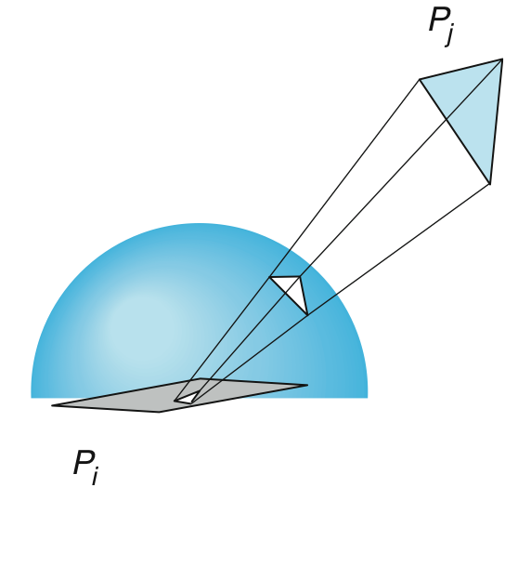
Hemisphere
Angel: Interactive Computer Graphics 5E © Addison-Wesley 2009

Slide 28
Hemicube
Easier to use a hemicube instead of a hemisphere
Rule each side into “pixels”
Easier to project on pixels which give delta form factors that can be added up to give desired from factor
To get a delta form factor we need only cast a ray through each pixel
Angel: Interactive Computer Graphics 5E © Addison-Wesley 2009

Slide 29
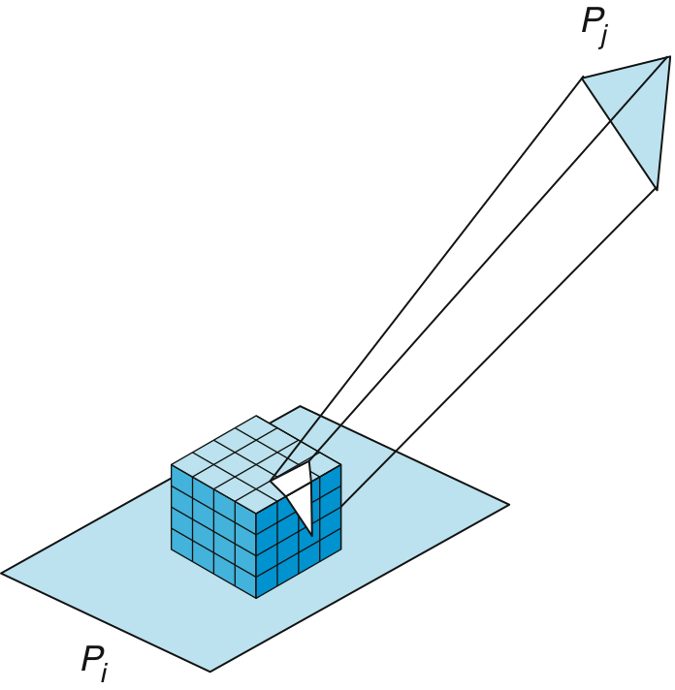
Hemicube
Angel: Interactive Computer Graphics 5E © Addison-Wesley 2009

Slide 30
Instant Radiosity
Want to use graphics system if possible
Suppose we make one patch emissive
The light from this patch is distributed among the other patches
Shade of other patches ~ form factors
Must use multiple OpenGL point sources to approximate a uniformly emissive patch
Angel: Interactive Computer Graphics 5E © Addison-Wesley 2009

